Slide 1
Private office space or co-working space

Slide 2
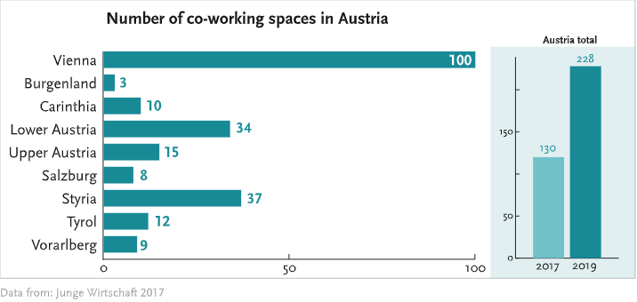
Situation in Austria (co-working)
co-working became more popular
Majority of the spaces are in Vienna
The fewest are in Burgendland

Slide 3
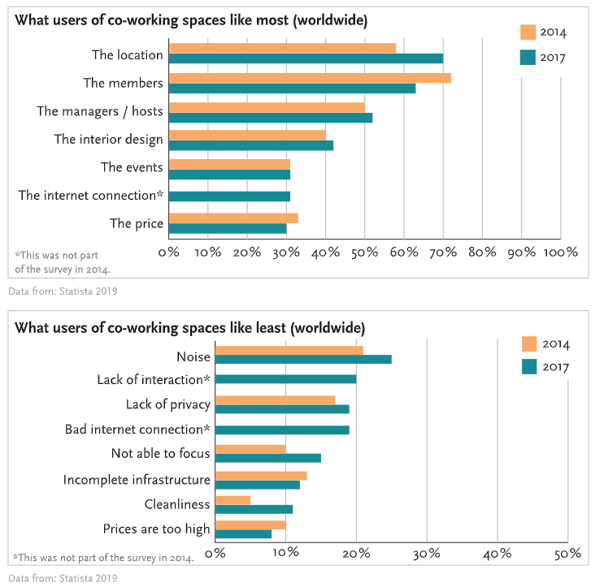
Pros & Cons of co-working
Pros:
The Location
Cost-Effective
The events
the members
Cons:
Lack of privacy
Distraction (Noise, …)
Lack of interactions
Not able to focus

Slide 4

Important features
Security
Privacy
Parking
Cost-Effective
A good Location
Regular networking events (workshops, seminars)

Slide 5

Summary
Rise of Co-Working Spaces
Cost-Effective
Human Contacts

Slide 6
Thanks for your attention

